Slide 1
Barter Trader
Group 1
Angus MacGillivray, Oliver Oliver, Prannat Jain, Khaled Hanafi
Notes:
Good Evening, Professor, Lead TA, Tutorial TA, and our Client TA. Our development team consisting of names...was tasked to design, develop, and test a mobile application that allows one to find people in the local area who are interested to exchange their used goods.

Slide 2
User Stories
Consisted of 12 user stories in total.
Client assigned 5 user stories as core to the application.

Slide 3
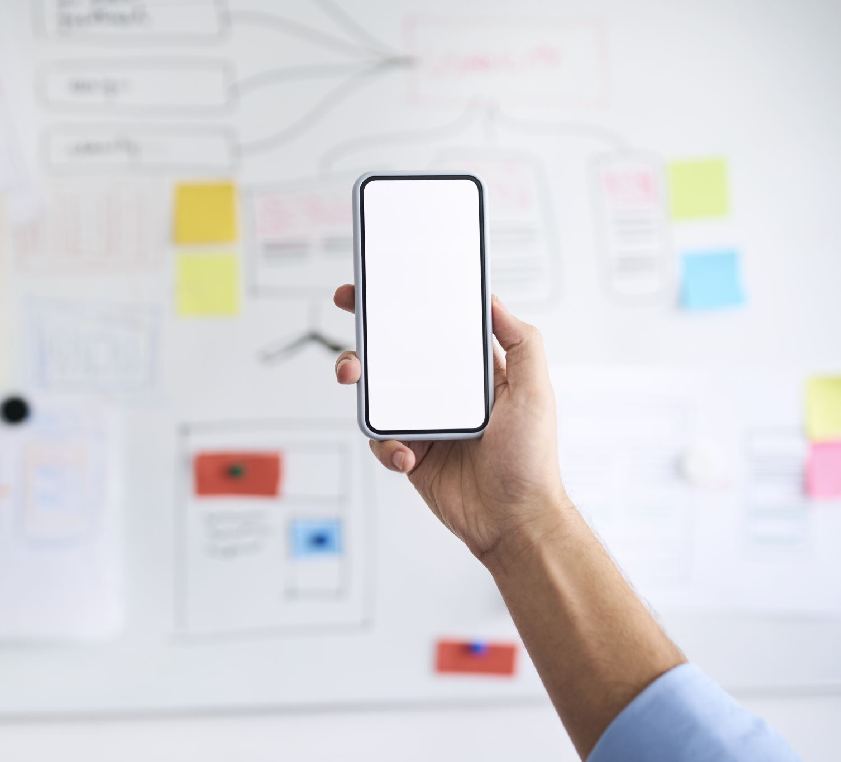
Main User Stories
Posting used goods to the app with necessary details as a provider.
Allow the receiver to search for used goods with various parameters.
Display products on Google Maps.
Chat functionality between prospect receivers and providers.
Providers’ ability to approve/reject exchange requests for their products.

Slide 4
What we Planned to Achieve
Login and registration features
Choose either provider or receiver when logging in
The ability to post products
Ability to search for products
Chat function
Ability to initiate an Exchange
Ability to set and store product preferences
Rating capabilities
Users receive an alert when a preferred product becomes available
Notes:
Khaled

Slide 5
What we Actually Achieved
Login and registration features
Choose either provider or receiver when logging in
The ability to post products
Ability to search for products
Chat function
Ability to initiate an Exchange

Slide 6
What we Failed to Achieve
Ability to set and store product preferences
Rating capabilities
Users receive an alert when a preferred product becomes available

Slide 7
Final Outcome

Slide 8
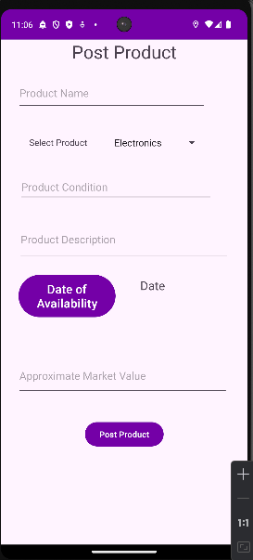
Posting used goods as a Provider

Slide 9
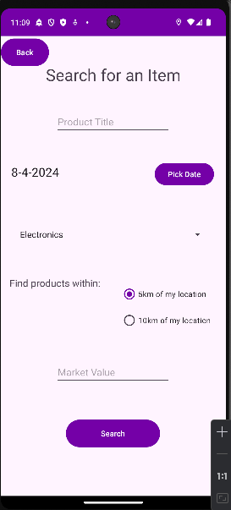
Receiver searching for used goods

Slide 10
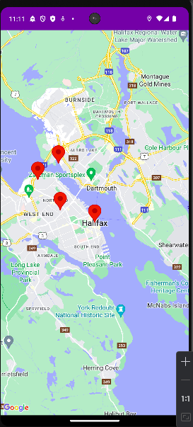
Display Products on Google Maps

Slide 11
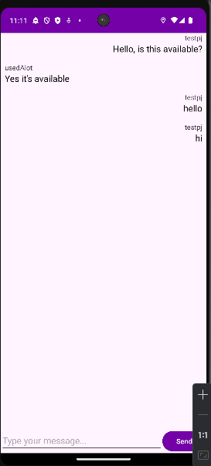
Chat Functionality

Slide 12
Providers’ ability to approve/reject exchange requests

Slide 13

Success in
Software Implementation
Chart
Notes:
Angus

Slide 14
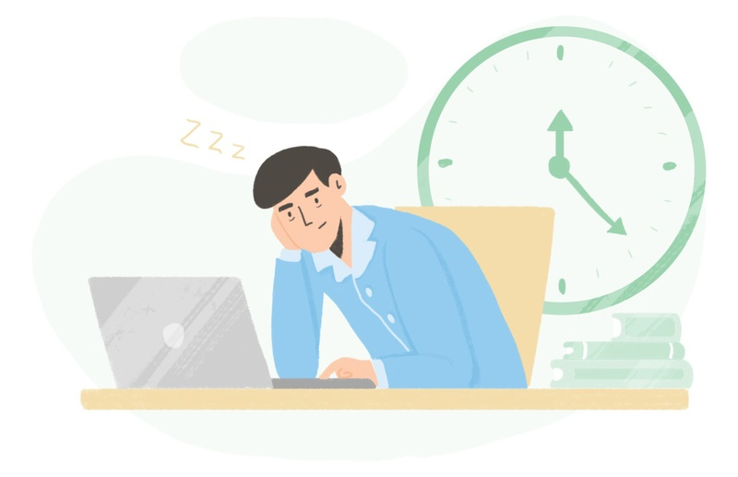
Challenge in
Software Implementation
Time Management

Slide 15
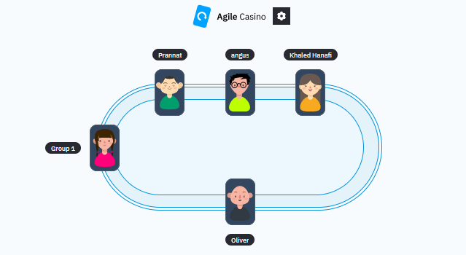
Success in
Software Process
Planning Game

Slide 16
Challenge in
Software Process
Peer Programming

Slide 17
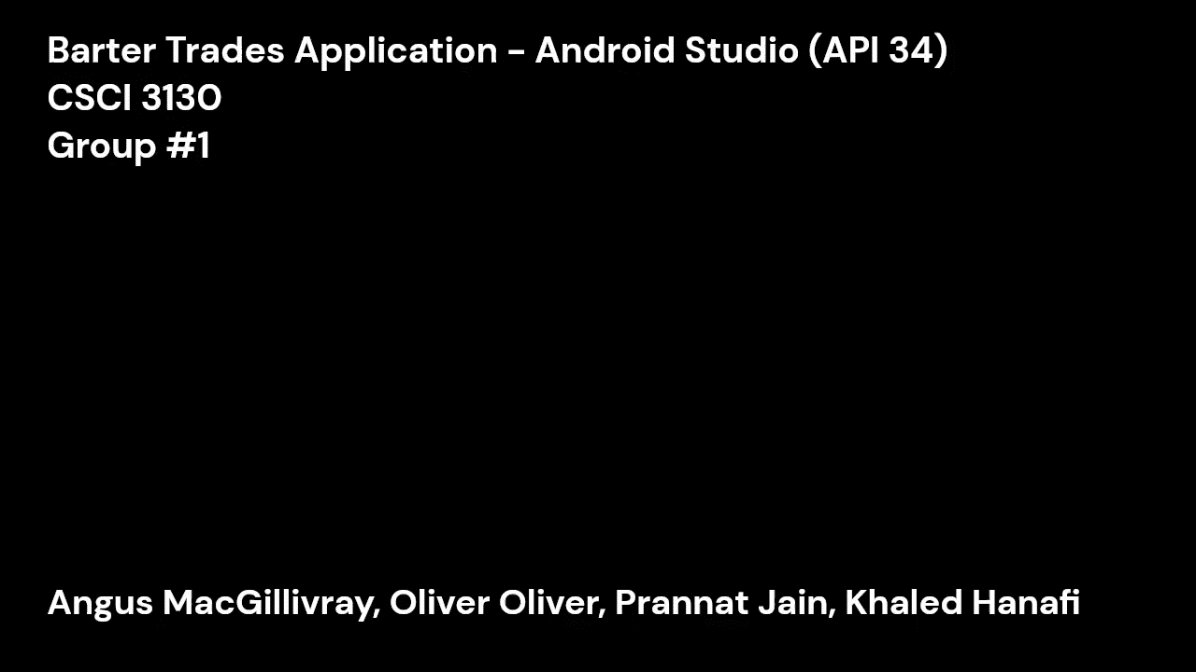
Demo Video

Slide 18

Q&A

